Slide 2
Q: What do you do? A: I VERB.
Q: Is it NOUN or Opposite NOUN? A: It is PICK 1 NOUN.
It is either NOUN or Opposite NOUN. It is neither NOUN nor OPPOSITE NOUN. “Frequency time words, like always & never or adjective-descriptions, go in front of the verb.
ADJ /ADVERB (NOUN PHRASE)
V
N
V
N./ADJ.
V
N
N
N
N.PHRASE/ADV.
N
N/ADJ.

Slide 3
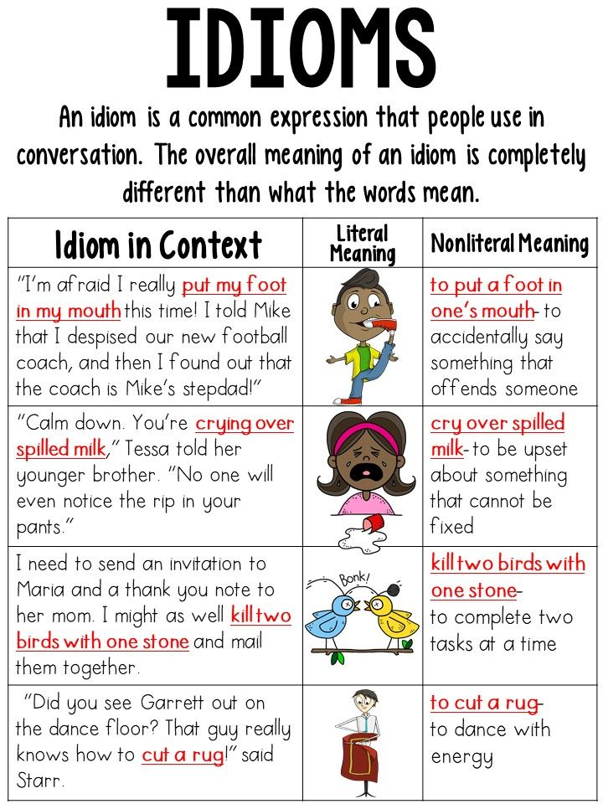

Slide 4
ESL Cafe-Partners
Going to=Future
Coming from=Where are you now? Starting place.
1 “Where are you going?”
and practice: (Going-You will be there in the future) “Where are you going?”
I am going to the office.
I am going on vacation.
I am going to work.
I am going to the market.
I am going to school.
I am going home.
(Coming from-Where are you now?) “Where are you coming from?”
I am coming from work.
I am coming from the bank.
I am coming from Ventura County.

Slide 6
