Slide 1
Problem: “The video is too fast. I cannot understand.” Solution-Step by Step: How to slow down the speed for most videos on YouTube
Tutorial: How to slow down “speed” for YouTube videos
Source: https://www.youtube.com/
Chinese: 問題：視頻太快。我不明白。解決方案循序漸進：如何放慢YouTube上大多數視頻的播放速度
Vietnamese: Vấn đề: Video quá nhanh. Tôi không thể hiểu. Giải pháp từng bước: Cách làm chậm tốc độ cho hầu hết các video trên YouTube
Spanish:
Problema: el video es demasiado rápido. No puedo entender. Solución paso a paso: cómo reducir la velocidad de la mayoría de los videos en YouTube
*For more language translations please click the “Google Translate Link” below:
https://translate.google.com/

Slide 2
Step 1: Click the “Settings Icon”
(It looks a flower or a wheel) at the bottom right side of your video

Slide 3
Step 2: You will see a check mark next to “Normal.” Click on the slower speed of 0.75 and press “Enter.”

Slide 4
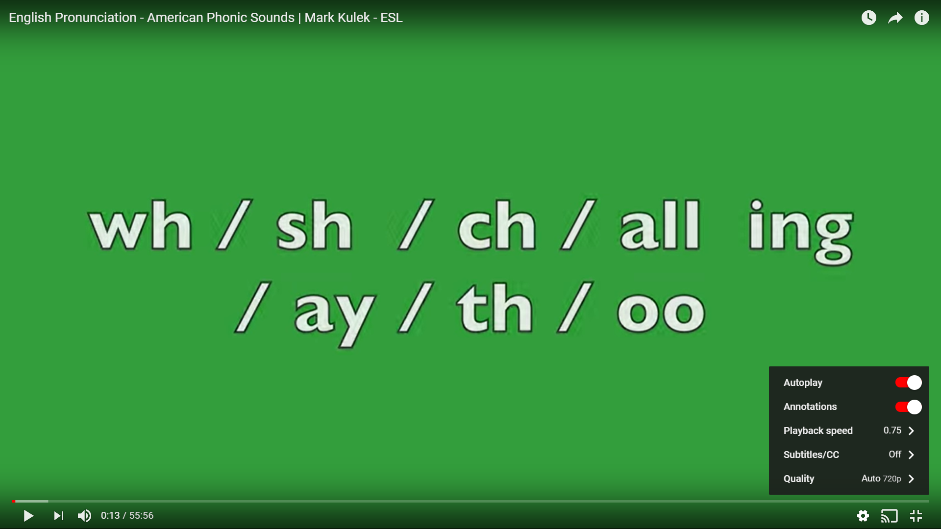
Step 3: Your speed is slower at “0.75.” Now, you can click “play”
and enjoy your video.
“Happy Learning and thank you for joining us!” ESL Teacher: Maria Eborn

