Slide 1
Tuesday, April 1st Agenda
Present the Dialogue from focus English that you chose with another classmate.
2. Review together HW- Applying “Did” technique to learn the past tense verbs.
Idioms pronunciation.
Dialogue-Going to and coming from.

Slide 2
Students: I am attaching the "ed" endings pronunciation chart that we used last time , along with 10+1 Bonus Present and Simple Past Irregular verb list to practice with our automatic "DID" question drill activity below:.
Did you ___________?
(Insert present verb)
I did ______________.
Insert present verb)
Oh! You _______.
(Insert simple past verb)
Yes, I _________.
(Insert simple past verb)
She also suggested an excellent video about the pronunciation of "ED" as an extensio **Here's a link to a good video about the 3 different past tense sounds when adding "ed“ https://www.youtube.com/watch?list=PL7BlTIDdOgZLa36qwWURDeyKL1n3lJ1vy&v=4_s12MkuvFQ&feature=emb_logo&disable_polymer=true

Slide 4
Q: What do you do? A: I VERB.
Q: Is it NOUN or Opposite NOUN? A: It is PICK 1 NOUN.
It is either NOUN or Opposite NOUN. It is neither NOUN nor OPPOSITE NOUN. “Frequency time words, like always & never or adjective-descriptions, go in front of the verb.
ADJ /ADVERB (NOUN PHRASE)
V
N
V
N./ADJ.
V
N
N
N
N.PHRASE/ADV.
N
N/ADJ.

Slide 5
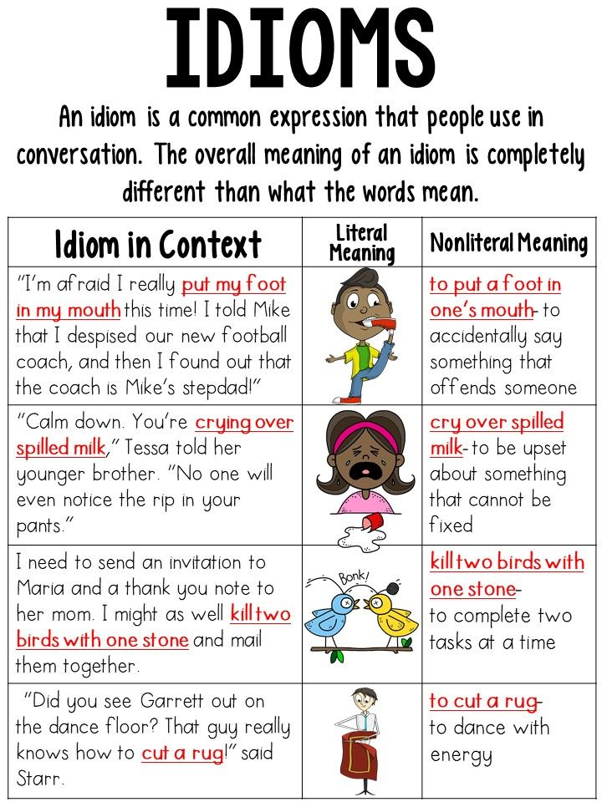

Slide 6
ESL Cafe-Partners
Going to=Future
Coming from=Where are you now? Starting place.
1 “Where are you going?”
and practice: (Going-You will be there in the future) “Where are you going?”
I am going to the office.
I am going on vacation.
I am going to work.
I am going to the market.
I am going to school.
I am going home.
(Coming from-Where are you now?) “Where are you coming from?”
I am coming from work.
I am coming from the bank.
I am coming from Ventura County.

Slide 8
